Slide 1
DECISION TREE Learning

Slide 2
Consider the dataset
Day
Outlook
Temperature
Humidity
Wind
PlayTennis
D1
Sunny
Hot
High
Weak
No
D2
Sunny
Hot
High
Strong
No
D3
Overcast
Hot
High
Weak
Yes
D4
Rain
Mild
High
Weak
Yes
D5
Rain
Cool
Normal
Weak
Yes
D6
Rain
Cool
Normal
Strong
No
D7
Overcast
Cool
Normal
Strong
Yes
D8
Sunny
Mild
High
Weak
No
D9
Sunny
Cool
Normal
Weak
Yes
D10
Rain
Mild
Normal
Weak
Yes
D11
Sunny
Mild
Normal
Strong
Yes
D12
Overcast
Mild
High
Strong
Yes
D13
Overcast
Hot
Normal
Weak
Yes
D14
Rain
Mild
High
Strong
No

Slide 3
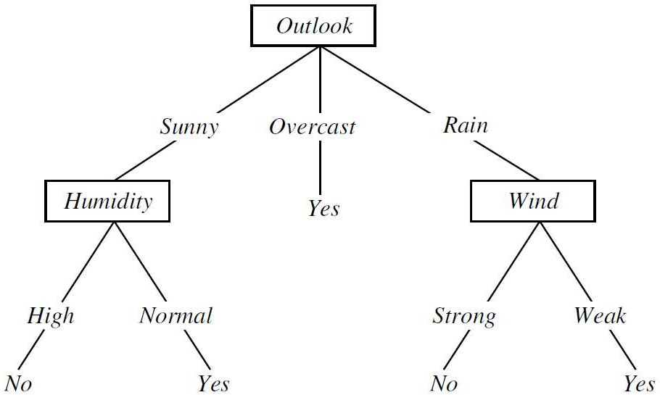
Decision Tree Representation
Each internal node tests an attribute
Each branch corresponds to an attribute value
Each leaf node assigns a classification
PlayTennis: This decision tree classifies Saturday mornings according to whether or not they are suitable for playing tennis

Slide 4
Decision Tree Representation - Classification
An example is classified by sorting it through the tree from the root to the leaf node
Example – (Outlook = Sunny, Humidity = High) => (PlayTennis = No)
PlayTennis: This decision tree classifies Saturday mornings according to whether or not they are suitable for playing tennis

Slide 5
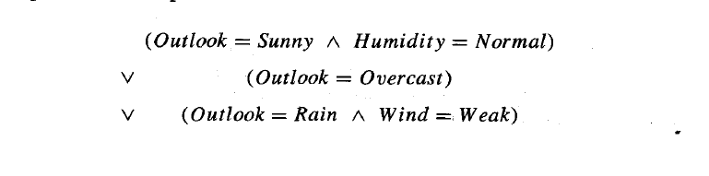
Decision Tree Representation
In general, decision trees represent a disjunction of conjunctions of constraints on the attribute values of instances
Example –

Slide 6
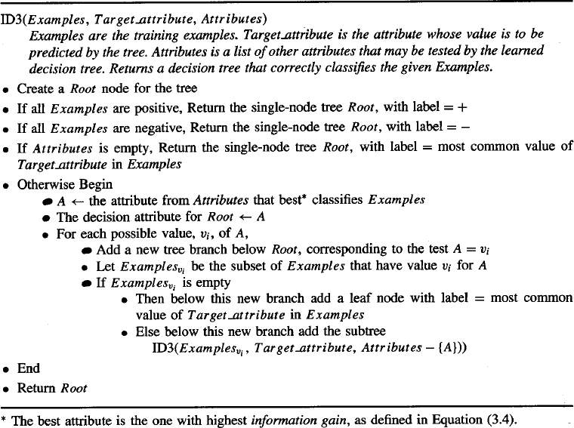
ID3 Algorithm

Slide 7

Entropy
Entropy (E) is the minimum number of bits needed in order to classify an arbitrary example as yes or no
Entropy is commonly used in information theory. It characterizes the (im)purity of an arbitrary collection of examples.
S is a sample of training examples
is the proportion of positive examples in S
is the proportion of negative examples in S
Then the entropy measures the impurity of S:
But If the target attribute can take c different values:

Slide 8

Information Gain
Information gain measures the expected reduction in Entropy
It measures the effectiveness of the attribute in classifying the training data
Gain(S,A) = expected reduction in entropy by partitioning the examples according to the attribute A
Here values(A) is the set of all possible values for attribute A, s_{v} is the subset of S for which atribute A has value v

Slide 9
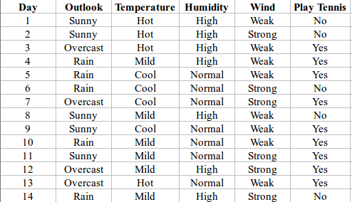
An Illustrative Example

Slide 10
Decision Tree Learning
Let’s Try an Example!
Let
E([X+,Y-]) represent that there are X positive training elements and Y negative elements.
Therefore the Entropy for the training data, E(S), can be represented as E([9+,5-]) because of the 14 training examples 9 of them are yes and 5 of them are no.

Slide 11
Decision Tree Learning: A Simple Example
Let’s start off by calculating the Entropy of the Training Set.
E(S) = E([9+,5-]) = (-9/14 log₂ 9/14) + (-5/14 log₂ 5/14)
= 0.94
Next we will need to calculate the information gain G(S,A) for each attribute A where A is taken from the set {Outlook, Temperature, Humidity, Wind}.

Slide 12
Decision Tree Learning: A Simple Example
The information gain for Outlook is:
Gain(S,Outlook) = E(S) – [5/14 * E(Outlook=sunny) + 4/14 * E(Outlook = overcast) + 5/14 * E(Outlook=rain)]
Gain(S,Outlook) = E([9+,5-]) – [5/14*E(2+,3-) + 4/14*E([4+,0]) + 5/14*E([3+,2-])]
Gain(S,Outlook) = 0.94 – [5/14*0.971 + 4/14*0.0 + 5/14*0.971]
Gain(S,Outlook) = 0.246
(- 2/5 log₂ (2/5) )+ (-3/5 log₂(3/5))

Slide 13
Decision Tree Learning: A Simple Example
Gain(S,Temperature) = 0.94 – [4/14*E(Temperature=hot) + 6/14*E(Temperature=mild) + 4/14*E(Temperature=cool)]
Gain(S,Temperature) = 0.94 – [4/14*E([2+,2-]) + 6/14*E([4+,2-]) + 4/14*E([3+,1-])]
Gain(S,Temperature) = 0.94 – [4/14 + 6/14*0.918 + 4/14*0.811]
Gain(S,Temperature) = 0.029

Slide 14
Decision Tree Learning: A Simple Example
Gain(S,Humidity) = 0.94 – [7/14*E(Humidity=high) + 7/14*E(Humidity=normal)]
Gain(S,Humidity = 0.94 – [7/14*E([3+,4-]) + 7/14*E([6+,1-])]
Gain(S,Humidity = 0.94 – [7/14*0.985 + 7/14*0.592]
Gain(S,Humidity) = 0.1515

Slide 15
Decision Tree Learning: A Simple Example
G(S,Wind) = 0.94 – [8/14*0.811 + 6/14*1.00]
G(S,Wind) = 0.048

Slide 16
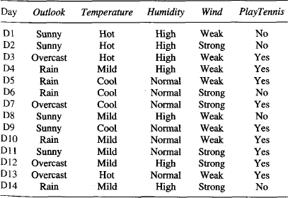
An Illustrative Example
Gain(S, Outlook) = 0.246
Gain(S, Humidity) = 0.151
Gain(S, Wind) = 0.048
Gain(S, Temperature) = 0.029
Since Outlook attribute provides the best prediction of the target attribute, PlayTennis, it is selected as the decision attribute for the root node, and branches are created with its possible values (i.e., Sunny, Overcast, and Rain).

Slide 17
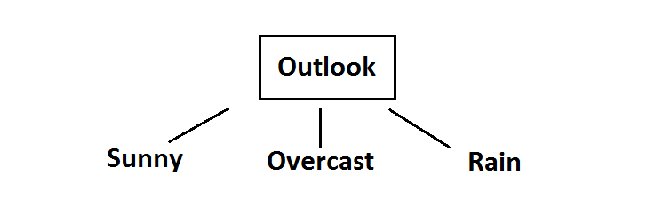
Root Node

Slide 18
An Illustrative Example
For Overcast – Decision Class can be obtained
Day | Outlook | Temp. | Humidity | Wind | Decision
3 | Overcast | Hot | High | Weak | Yes
7 | Overcast | Cool | Normal | Strong | Yes
12 | Overcast | Mild | High | Strong | Yes
13 | Overcast | Hot | Normal | Weak | Yes

Slide 19
An Illustrative Example
Day | Outlook | Temp. | Humidity | Wind | Decision
1 | Sunny | Hot | High | Weak | No
2 | Sunny | Hot | High | Strong | No
8 | Sunny | Mild | High | Weak | No
9 | Sunny | Cool | Normal | Weak | Yes
11 | Sunny | Mild | Normal | Strong | Yes
For Sunny– Decision Class cannot be obtained
Day | Outlook | Temp. | Humidity | Wind | Decision
4 | Rain | Mild | High | Weak | Yes
5 | Rain | Cool | Normal | Weak | Yes
6 | Rain | Cool | Normal | Strong | No
10 | Rain | Mild | Normal | Weak | Yes
14 | Rain | Mild | High | Strong | No
For Rain– Decision Class cannot be obtained

Slide 20
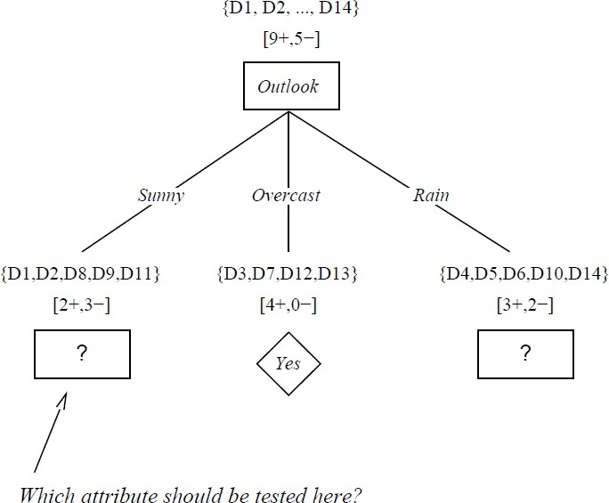
An Illustrative Example

Slide 21
Intermediate node computation
S_{sunny} = {D1,D2,D8,D9,D11}
Entropy (S_{sunny} ) = (-2/5 log 2/5 ) + ( -3/5 log 3/5) = 0.97
Gain (S_{sunny} , Humidity)
= .970 - (3/5) 0.0 - (2/5) 0.0
= .970
Gain (S sunny , Temperature)
= .970 - (2/5) 0.0 - (2/5) 1.0 - (1/5) 0.0
= .570
Gain (S sunny , Wind)
= .970 - (2/5) 1.0 - (3/5) .918
= .019
[3/5 * ((-0/3 log 0/3) + ((-3/3 log (3/3))] + [2/5 * ((-2/2 log(2/2) + ((-0/2 log (0/2))]

Slide 22
Intermediate node computation
For the rightmost branch: Rain
Gain (S_{Rain}, Temperature) = 0.019
Gain (S_{Rain}, Humidity) = 0.019
Gain (S_{Rain}, Wind)= 0.97

Slide 23
FINAL decision tree :

